Slide 1
HTML Lists and Tables

Slide 2
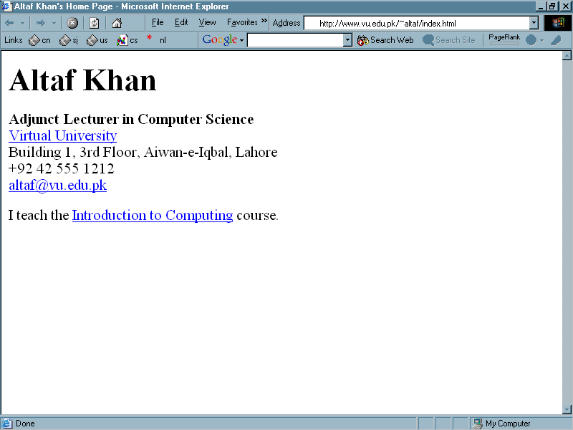

Slide 3
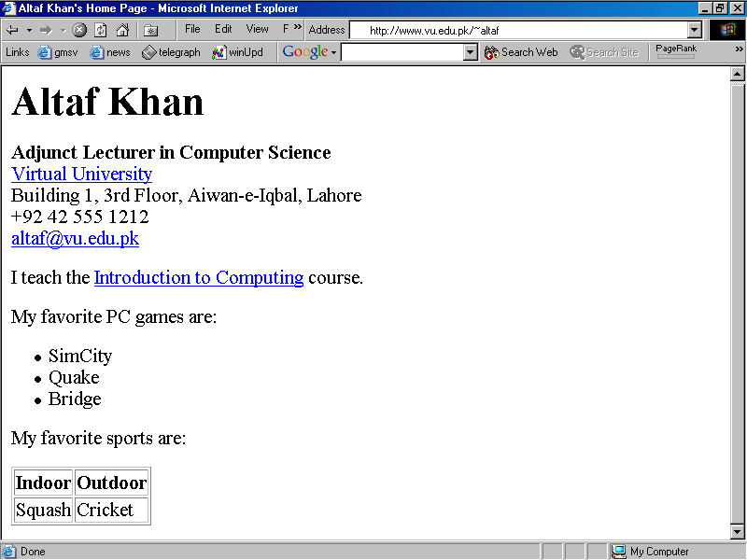

Slide 4
List

Slide 5
Table

Slide 6
<HTML>
<HEAD>
<TITLE>Altaf Khan's Home Page</TITLE>
</HEAD>
<BODY>
<H1>Altaf Khan</H1>
<P><B>Adjunct Lecturer in Computer Science</B><BR>
<A HREF="http://www.vu.edu.pk/">Virtual University</A><BR>
Building 1, 3rd Floor, Aiwan-e-Iqbal, Lahore<BR>
+92 42 555 1212<BR>
<A HREF="mailto:altaf@vu.edu.pk">altaf@vu.edu.pk</A><BR></P>
<P>I teach the <A HREF="http://www.vu.edu.pk/cs101/">Introduction to Computing</A> course. </P>
</BODY>
</HTML>

Slide 7
<HTML>
<HEAD>
<TITLE>Altaf Khan's Home Page</TITLE>
</HEAD>
<BODY>
<H1>Altaf Khan</H1>
<P><B>Adjunct Lecturer in Computer Science</B><BR>
<A HREF="http://www.vu.edu.pk/">Virtual University</A><BR>
Building 1, 3rd Floor, Aiwan-e-Iqbal, Lahore<BR>
+92 42 555 1212<BR>
<A HREF="mailto:altaf@vu.edu.pk">altaf@vu.edu.pk</A><BR></P>
<P>I teach the <A HREF="http://www.vu.edu.pk/cs101/">Introduction to Computing</A> course. </P>
</BODY>
</HTML>
The additional code for the list and table goes here

Slide 8
<P>My favorite PC games are:</P>
<UL>
<LI>SimCity</LI>
<LI>Quake</LI>
<LI>Bridge</LI>
</UL>
<P>My favorite sports are:</P>
<TABLE border = “1” >
<TR>
<TH>Indoor</TH>
<TH>Outdoor</TH>
</TR>
<TR>
<TD>Squash</TD>
<TD>Cricket</TD>
</TR>
</TABLE>
Code for the list

Slide 9
<P>My favorite PC games are:</P>
<UL>
<LI>SimCity</LI>
<LI>Quake</LI>
<LI>Bridge</LI>
</UL>
<P>My favorite sports are:</P>
<TABLE border = “1” >
<TR>
<TH>Indoor</TH>
<TH>Outdoor</TH>
</TR>
<TR>
<TD>Squash</TD>
<TD>Cricket</TD>
</TR>
</TABLE>
Code for the Table

Slide 10
HTML Lists & Tables
Lists are one way of presenting data in a an ordered or formal fashion
Tables provide another - more customizable - way of displaying ordered information on Web pages

Slide 11
Types of Lists
  Unordered Lists
  Ordered Lists
  Definition List

Slide 12

Unordered List
<UL> | Un-ordered List
<LI> | Line Item

Slide 13
HTML Code
Browser Display
<UL>
<LI>SimCity</LI>
<LI>Quake</LI>
<LI>Bridge</LI>
</UL>
  SimCity
  Quake
  Bridge

Slide 14
Unordered List Types
type | Result
“disc” | disc (default)
“circle” | circle
“square” | square
“none” | Items will not be marked

Slide 15
The default “bullet” for these lists is a “disc”
That, however, can be changed to a “circle” or a “square” with the help of the type attribute

Slide 16
HTML Code
Browser Display
<UL type = “circle”>
<LI>SimCity</LI>
<LI>Quake</LI>
<LI>Bridge</LI>
</UL>
  SimCity
  Quake
  Bridge

Slide 17
type = “square”

Slide 18
Q: What happens if I start a new list without closing the original one?
<UL>
<LI>SimCity</LI>
<LI>Quake II</LI>
<UL>
<LI>SimCity 3000</LI>
<LI>Quake III</LI>
</UL>
<LI>Bridge</LI>
</UL>

Slide 19
Browser Display
Different bullets
Additional tab
  SimCity
  Quake II
    SimCity 3000
    Quake III
  Bridge

Slide 20
Such structures, i.e., those in which another starts before the first list is finished, are called Nested Lists

Slide 21
Ordered List
<OL> | Ordered List
<LI> | Line Item

Slide 22
Ordered List
Browser Display
OL instead of UL
<OL>
<LI>SimCity</LI>
<LI>Quake</LI>
<LI>Bridge</LI>
</OL>
  SimCity
  Quake
  Bridge
Numbers instead of discs, circles or squares

Slide 23
Ordered List Types
type | Result
“A” | A, B, C, …
“a” | a, b, c, …
“I” | I, II, III, IV, …
“i” | i, ii, iii, iv, …
“1” | 1, 2, 3, …

Slide 24
Ordered List
Browser Display
<OL type = “a”>
<LI>SimCity</LI>
<LI>Quake</LI>
<LI>Bridge</LI>
</OL>
  SimCity
  Quake
  Bridge

Slide 25
Q: How would one start an ordered list with something other than 1
Browser Display
  SimCity
  Quake
  Bridge

Slide 26
Ordered List
Browser Display
<OL start = “25”>
<LI>SimCity</LI>
<LI>Quake</LI>
<LI>Bridge</LI>
</OL>
  SimCity
  Quake
  Bridge

Slide 27
HTML tables
Browser Display
Indoor | Outdoor
Squash | Cricket

Slide 28
<TABLE> | Table (made up of rows)
<TR> | Row (made up of data cells)
<TH> | Heading Data Cell (Can contain paragraphs, images, lists, forms, tables)
<TD> | Data Cell (Can contain paragraphs, images, lists, forms, tables)

Slide 29
HTML Code
Browser Display
<TABLE border = "1" >
<TR>
<TH>Indoor</TH>
<TH>Outdoor</TH>
</TR>
<TR>
<TD>Squash</TD>
<TD>Cricket</TD>
</TR>
</TABLE>
Indoor | Outdoor
Squash | Cricket

Slide 30
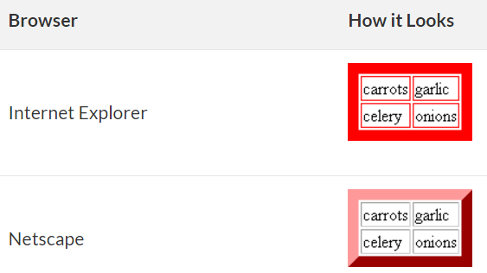
<TABLE> Attributes
BORDER
  Determines the thickness of the table border
  Example: <TABLE BORDER = “2”>
BORDERCOLOR
  The color of the table borders as a whole is set with the BORDERCOLOR attribute
  <TABLE BORDER=10 BORDERCOLOR=RED>
Netscape maintains the 3-D appearance.

Slide 31
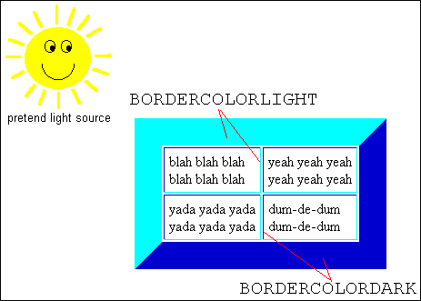

BORDERCOLORLIGHT, BORDERCOLORDARK
<TABLE BORDER=10 BORDERCOLORLIGHT=YELLOW BORDERCOLORDARK=BLUE>

Slide 32
<TABLE> Attributes
CELLPADING
  Determines the distance between the border of a cell and the contents of the cell
  Example: <TABLE CELLPADDING = “3”>
CELLSPACING
  Determines the empty spacing between the borders of two adjacent cells
  Example: <TABLE CELLSPACING = “1”>

Slide 33
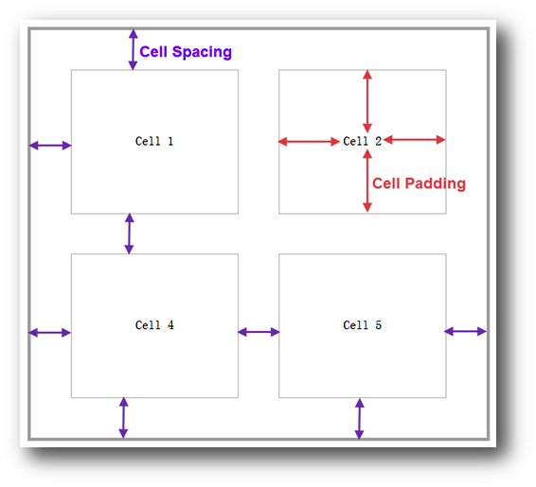

Slide 34
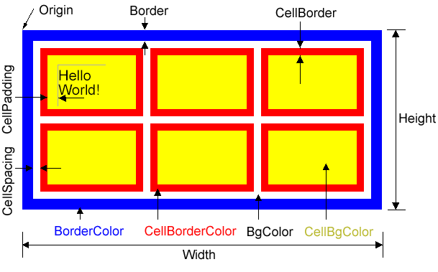

Slide 35
HTML Code
Browser Display
<TABLE border = "1" >
<TR>
<TH>Indoor</TH>
<TH>Outdoor</TH>
</TR>
<TR>
<TD>Squash</TD>
<TD>Cricket</TD>
</TR>
</TABLE>
Indoor | Outdoor
Squash | Cricket

Slide 36
HTML Code
Browser Display
<TABLE>
<TR>
<TH>Indoor</TH>
<TH>Outdoor</TH>
</TR>
<TR>
<TD>Squash</TD>
<TD>Cricket</TD>
</TR>
</TABLE>
Indoor | Outdoor
Squash | Cricket

Slide 37
<TABLE>,<TR>,<TH>,<TD> Attributes
ALIGN
  Possible values: Center, Left, Right
  Example: <TH ALIGN = “center”>
BGCOLOR
  Example: <TD BGCOLOR = “red”>
WIDTH
  Example: <TR WIDTH = “40%”>
HEIGHT
  Example: <TABLE HEIGHT = “200”>
40% of the screen width

Slide 38
<TR> Attributes
VLAIGN
  Determines the vertical alignment of the contents of all of the cells in a particular row
  Possible values: Top, Middle, Bottom
  Example: <TR VALIGN = “bottom”>

Slide 39
<TH> & <TD> Attributes
NOWRAP
  Extend the width of a cell, if necessary, to fit the contents of the cell in a single line
  Example: <TD NOWRAP>
COLSPAN
  No. of rows the current cell should extend itself downward
  Example: <TD COLSPAN = “2”>
ROWSPAN
  The number of columns the current cell should extend itself
  Example: <TD ROWSPAN = “5”>
VALIGN
  Same as that for <TR>

Slide 40
HTML Code
Browser Display
<TABLE border=“1” >
<TR>
<TH colspan=“2”> Indoor Outdoor
</TH>
</TR>
<TR>
<TD>Squash</TD>
<TD>Cricket</TD>
</TR>
</TABLE>
Indoor Outdoor
Squash | Cricket

Slide 41
Year | Quarter | Expenses |  | Income
 |  | Quetta | Dubai | Quetta | Dubai
2001 | 1 | 1,900 | 8,650 | 9,000 | 7,780
 | 2 | 2,230 | 8,650 | 8,500 | 8,670
 | 3 | 4,000 | 8,650 | 9,900 | 9,870
 | 4 | 2,200 | 8,650 | 9,800 | 9,900
2002 | 1 | 7,780 | 8,650 | 7,780 | 9,000
 | 2 | 8,670 | 8,650 | 8,670 | 8,500
 | 3 | 9,870 | 8,650 | 9,870 | 9,900
 | 4 | 9,900 | 8,650 | 9,900 | 9,800

Slide 42
HTML Code
Browser Display
<TABLE border = "1" >
<CAPTION>
My favorite sports
</CAPTION>
<TR>
<TD>Squash</TD>
<TD>Cricket</TD>
</TR>
</TABLE>
My favorite sports
Squash | Cricket

Slide 43
HTML Code
Browser Display
<TABLE border = "1" >
<CAPTION>
My favorite sports
</CAPTION>
<TR>
<TD>Squash</TD>
<TD>Cricket</TD>
</TR>
</TABLE>
My favorite sports
Squash | Cricket
Must be placed immediately after the<TABLE> tag

Slide 44
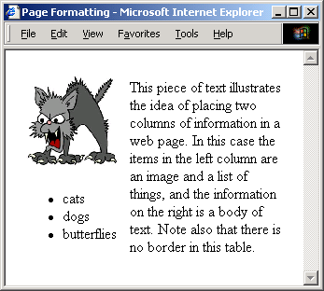
Page formatting
</body>
<table border="0" cellspacing="10">
<tr>
<td>
<img src="cat.gif" alt="cat">
<ul>
<li>cats</li>
<li>dogs</li>
<li>butterflies</li>
</ul>
</td>
<td>
This piece of text illustrates
the idea of placing two columns
of information in a web page...
Note also that there is no
border in this table.
</td>
</tr>
</table>
</body>
Tables can be used to organise the layout of the web page itself

Slide 45
